Slide 1
Cervical lymphadenopathy and neck mass
DR:Mariwan latif fatah
M.B.ch.B F.I.C.M.S

Slide 2
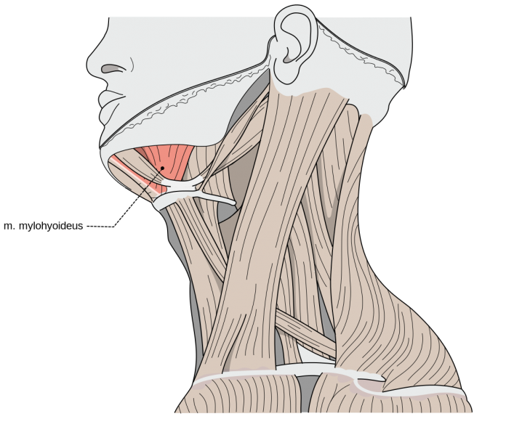
levels of the neck (6 levels)
Level I
below myohyoid muscle and above the lower margin of the hyoid bone
anterior to the posterior border of the submandibular glands
level Ia : sub mental - between the anterior bellies of the digastric muscle
level Ib : sub mandibular - posterolateral to the anterior belly of digastric
drains the lip, oral cavity and tongue

Slide 3
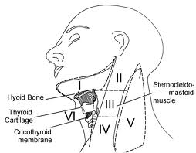

Slide 4
Level II
jugulodigastric .
base of skull to lower margin of hyoid bone.
anterior to the posterior border of sternocleidomastoid (SCM).
posterior to the posterior border of the submandibular glands .
Drains the oropharynx, larynx, hypopharynx and parotid gland.
The course of the spinal accessory nerve divides this level into two subzones.
Level IIa lies anteroinferior to the spinal accessory nerve
Level lIb posterosuperior.

Slide 5
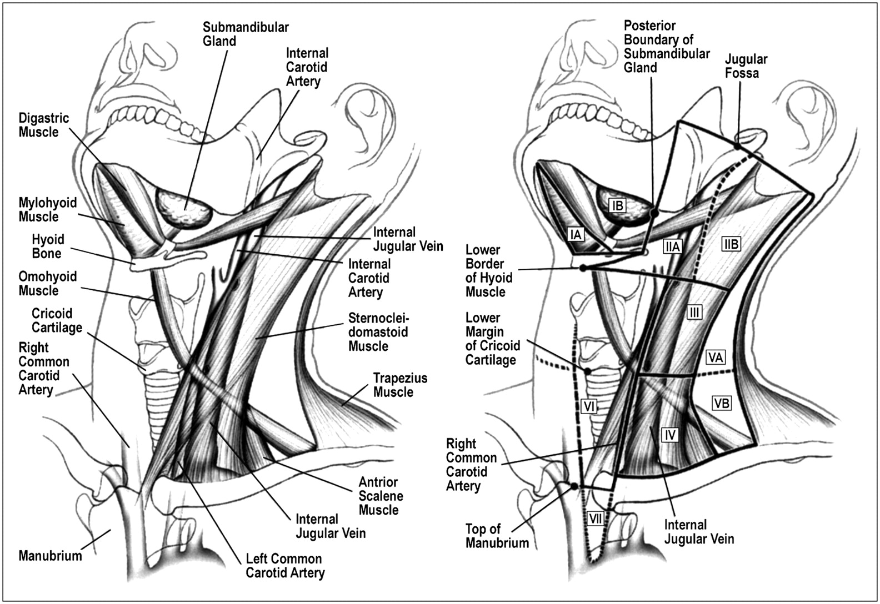
Level III
middle jugular nodes.
lower margin of hyoid to lower margin of cricoid cartilage.
anterior to the posterior border of SCM.
Drains larynx and pharynx.

Slide 6
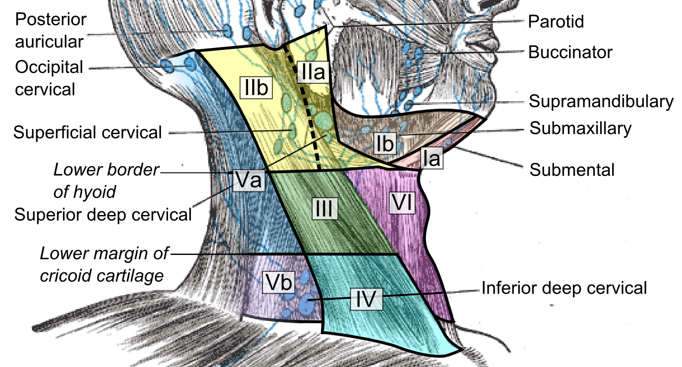
Level IV
low jugular nodes .
lower margin of cricoid cartilage to level of the clavicle.
Drains larynx and hypopharynx.

Slide 7
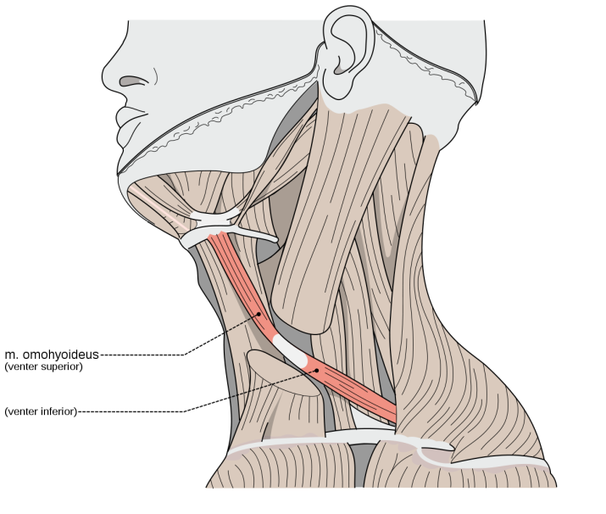
Level V
posterior triangle nodes .
It has been divided into sub zones.
level Va lies superior to the inferior belly of the omohyoid muscle .
level Vb level is inferior to the omohyoid muscle.
The Va area contains the chain of nodes along the accessory nerve, which drain the nasopharynx.
The Vb level contains nodes related to the thyrocervical trunk which drains the thyroid gland.

Slide 8
Level VI (anterior or central group)
prelaryngeal / pretracheal / Delphian node .
from inferior margin of hyoid to manubrium.

Slide 9
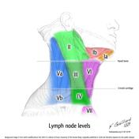
Level VII
superior mediastinum.
between CCAs, below top of manubrium.

Slide 10
Evaluation of a patient with a neck swelling requires a careful and systematic clinical approach with understanding of the anatomical structures of the neck and appreciation of the pathology.

Slide 11
HISTORY
The key points in the history that will help reach a diagnosis are the age of the patient, duration and location of the neck mass.
Dysphonia, sore throat, dysphagia, odynophagia,referred otalgia and nasal obstruction may suggest a neoplasm of the upper aerodigestive tract.
Weight loss, anorexia, malaise and night sweats (‘B’ symptoms) may suggest lymphoma or tuberculosis.

Slide 12
Past medical history of exposure to tuberculosis, irradiation (risk factor for malignancy),
occupational/sexual history (e.g. risk factors for human immunodeficiency virus
foreign travel and contact with pets (e.g.cat scratch disease) are also relevant.

Slide 13
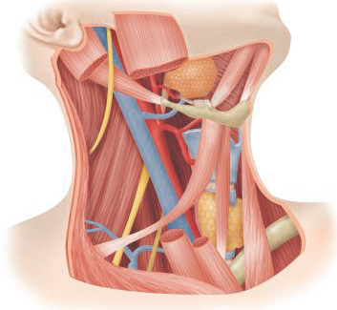
EXAMINATION
The neck masses should be assessed and recorded in a systematic fashion with emphasis on the number, size, site, shape and consistency.
It is convenient to use the neck nodal level system to describe the location of lymph node disease in the neck.

Slide 14
Inspection of the scalp, skin over the face and neck is necessary to look for potential sources of pathology.
Otolaryngologists are best placed to evaluate neck masses as clinical examination is incomplete unless the entire mucosa of the upper aerodigestive tract is examined

Slide 15
This includes endoscopic assessment of the nasal cavity, nasopharynx, oropharynx, larynx and hypopharynx.
Where facilities exist, a transnasal oesophagoscopy will allow examination of the oesophagus down to the cardia.
The examination should conclude with a general physical examination to include the chest, axillae and breasts in women.

Slide 16
Important signs that should raise concern matted nodes (often felt in lymphoma), nodes that feel hard or rounded (usually indicating malignancy) and ulceration or masses in the upper aerodigestive tract (which can indicate a primary cancer).

Slide 17
INVESTIGATIONS
In the majority of patients with neck lumps, an ultrasound and a needle biopsy are the first-line investigations.
If an inflammatory mass is suspected, especially in a young patient, hematological investigations including blood counts, inflammatory markers, viral titers, serology for Brucella spp. and Toxoplasma spp.

Slide 18
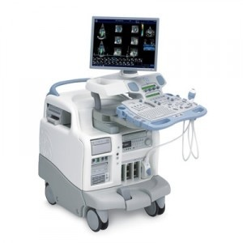
ULTRASOUND IMAGING
Ultrasound (US) is a useful modality in the evaluation of all lumps, especially of thyroid and salivary Origin.
with the added ability to precisely target tissue for fine-needle cytology.
Currently available higher resolution probes can study the architecture of the lump and identify features that have high predictive values for benign or malignant diagnoses.
It is relatively inexpensive, quick, non-invasive, and does not use ionizing radiation, but is operator dependent.

Slide 19
COMPUTERIZED TOMOGRAPHY
Computerized tomography (CT) is useful in identifying the presence of clinically undetectable lesions (e.g. deep-seated masses in Para pharyngeal and retropharyngeal spaces) and in delineating the extent, vascularity and relationship of neck lumps to adjacent structures.
It is used routinely for the staging of head and neck tumours and also in the investigation of a patient with an unknown primary presenting with metastatic neck disease.

Slide 20
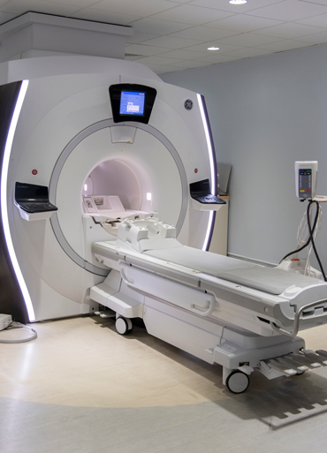
MAGNETIC RESONANCE IMAGING
Magnetic resonance imaging (MRI) has uses that are similar to CT, but it also provides very good soft tissue contrast and is the preferred modality where soft tissue detail is important, for instance the oropharynx and parotid gland.
MR angiograms are an excellent modality for vascular delineation

Slide 21
POSITRON EMISSION TOMOGRAPHY
Positron emission tomography (PET) is a functional imaging technique that depicts tissue metabolic activity and uses short-lived radioisotopes that contain protons that decay emitting positrons.
PET is rarely used as a sole imaging modality, but PET-CT or PET-MRI is especially useful in assessing patients presenting with metastatic neck disease with an unknown primary and following treatment for head and neck cancer.

Slide 22
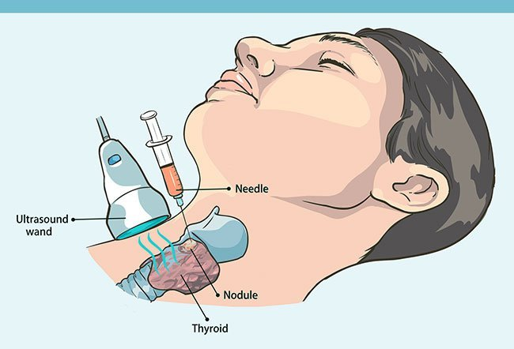
FINE-NEEDLE ASPIRATION CYTOLOGY
Fine-needle aspiration cytology (FNAC) is currently regarded as the key diagnostic modality for neck lumps and can be done with or without US guidance

Slide 23
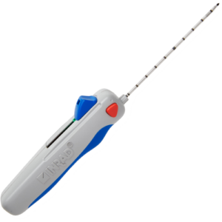
CORE BIOPSY
Core biopsy (CB) is a valuable adjunct to the diagnostic process when FNAC is unsuccessful.
Although there had been earlier fears of seeding the CB needle tract, these are largely unfounded.
CBs are especially valuable to characterize salivary gland malignancies and lymphomas.

Slide 24
OPEN BIOPSY
Open biopsy (OB) may be necessary if both FNAC and CB are unhelpful, imaging modalities suggest a malignant process but the primary is unknown or when the diagnosis is a lymphoma.

Slide 25
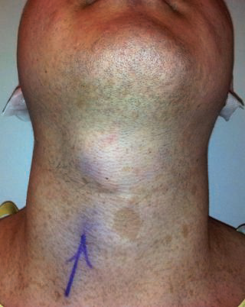
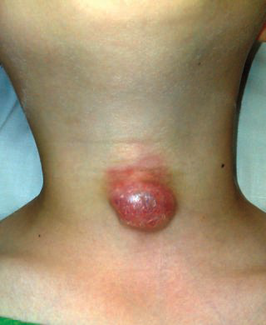
Neck Masses in an Adult
(Midline)
1-Inflammatory thyroiditis.
2-Non-inflammatory
A. Dermoid cyst.
B. Thyroglossal duct cyst.
C. Thyroid nodules.
D. Thymic cyst.
E.Lymphoedema.
thyroglossal duct cyst

Slide 26
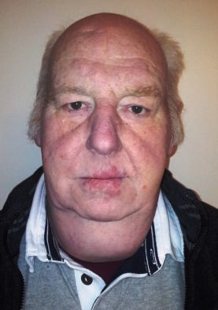
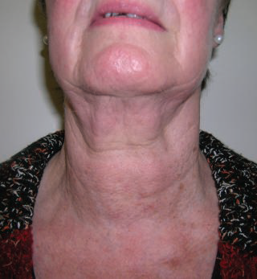
Thyroid enlargement post radiation lymphedema

Slide 27
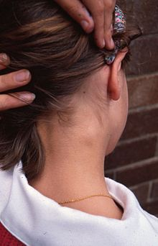
Lateral neck mass
A.Inflammatory
Reactive lymphadenopathy
Infective lymphadenopathy
(HIV, TB)
Submandibular sialadenitis
Parotitis
Kikuchi’s disease
Kawasaki syndrome
cervical LA

Slide 28
B. Non-inflammatory
Benign
Branchial cyst.
Laryngocoele.
Parotid tumours.
Schwannoma.
Paraganglioma.
Fibroblastic/myofibroblastic lesions
Lipoma
Parapharyngeal space tumours

Slide 29
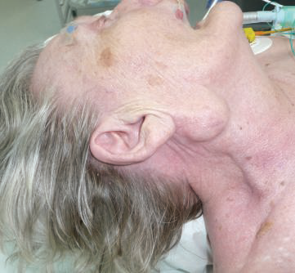
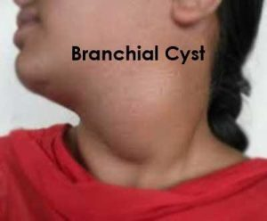
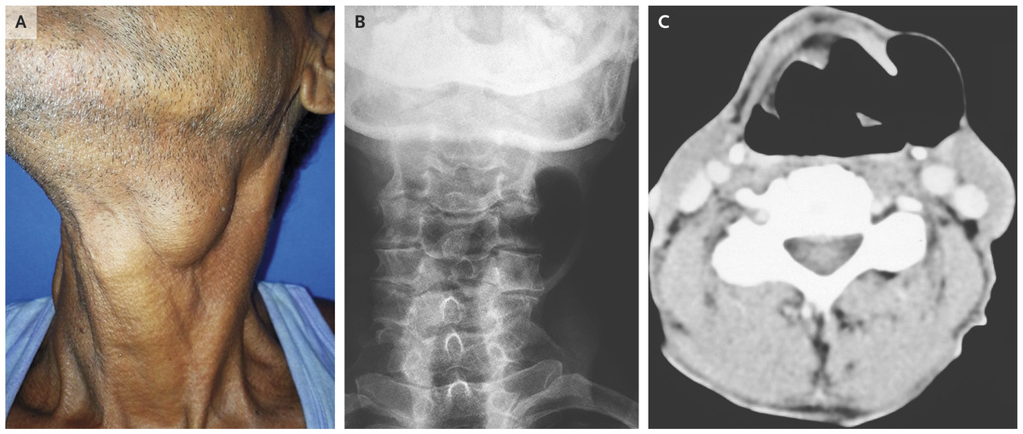
Parotid mass
laryngocele

Slide 30
Malignant
Metastatic squamous cell cancer
Primary parotid cancers or metastases to lymph nodes
Metastatic thyroid cancer
Lymphomas
Adenocarcinoma from distant sites

Slide 31
APPROACH TO TREATMENT PLANNING
In the presence of benign pathology, the only treatment available is surgical excision, but patient wishes and expectations are paramount.

Slide 32
Treatment for head and neck cancer is a rapidly evolving field, and treatment planning is best undertaken in a multidisciplinary setting where appropriate expertise is available.
national guidelines or local protocols are often used to guide treatment.
Relying on a positive FNAC alone to plan treatment in patients with head and neck cancer is a strategy beset with hazard, given the reported 3–10 per cent false positive rates.
One should always try to ensure that a definitive biopsy is available

Slide 33
Rule of 7 in the neck
7 days—inflammation
7 months—neoplasm
7 years—congenital defect
Note: The Rule of 7 provides a probable diagnosis of the neck mass based on the average duration of the patient’s symptoms

Slide 34


